Slide 1
GLOBAL WARMING
BY:
MARIA PAULA MENDOZA ZEPEDA
ANDRES BARBA DEHMLOW
FATIMA ALCOCER GONZALEZ
MARIA JOSE LEAL GODINEZ

Slide 2
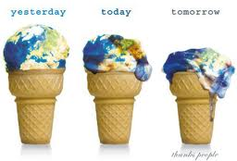
What is Global Warming?
Global warming is the rise in the average temperature of Earth s atmosphere and oceans since the late 19th century and its projected continuation.

Slide 3
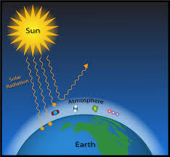
What is a greenhouse gas?
A gas that contributes to the greenhouse effect by absorbing infrared radiation. Carbon dioxide and chlorofluorocarbons are examples of greenhouse gases.

Slide 4
How can we help?
We can help the world by:
Using a bicicle if it is not a far way destination.

Slide 5
We can make?
Things like:
Reducing the use of light and energy like:
Use less time watching TV!!!
Turn of the lights when you are not using them.
Instead… This is a book:
Read a book!!!!!!!!!!!!!!!

Slide 6
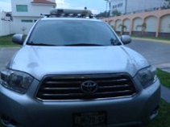
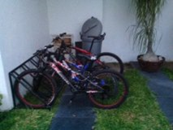
We can make a change:
BY:
Andres Barba Dehmlow:

Slide 7
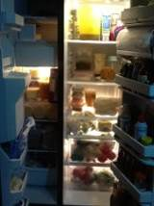
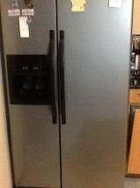
We can make a change:
BY:
Maria Paula Mendoza:

Slide 8
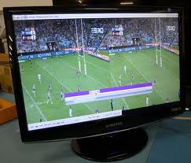
We can make a change:
BY:
Maria Jose Leal Godinez:

Slide 9
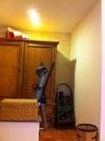
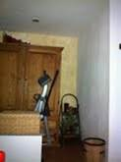
We can make change:
BY:
Fatima Alcocer Gonzalez:

