Slide 1
I SPY
20/20 PROJECT
´GLOBAL WARMING’
Sabrina Castro
Daniel Chagüén
Danna Michelle
José Flores

Slide 2
Our project
Global Warming is the increase of Earth's average surface temperature. All this it´s caused by burning of fossil fuels, carbon dioxide,etc.
Greenhouse effect: Gasses that heats up the Earth’s athmosphere.
GLOBAL WARMING AND GREEN HOUSE EFFECT

Slide 3
10 actions that decrease global warming

Slide 4
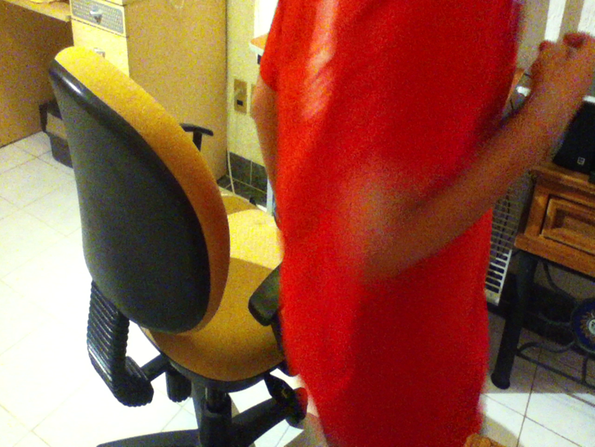
Unplugging the computer is good because by having the computers all day connected we waste energy that is made of toxic gases for our atmosphere.

Slide 5
We use bike insted of cars. And we use less gasoline and don’t burn fossil fuels and thats good for our planet and our enviroment

Slide 6
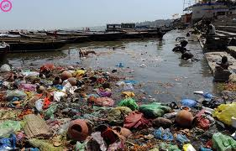
Taking out the garbage:instead of trow it the atrash to the floor or water we take it out.

Slide 7
While the water warms up ,we recolect the water in a bucket. And that is good because we don’t let the water be wasted , in time all the water could finish .

Slide 8
Separate trash is good because we don’t let the trash combine

Slide 9
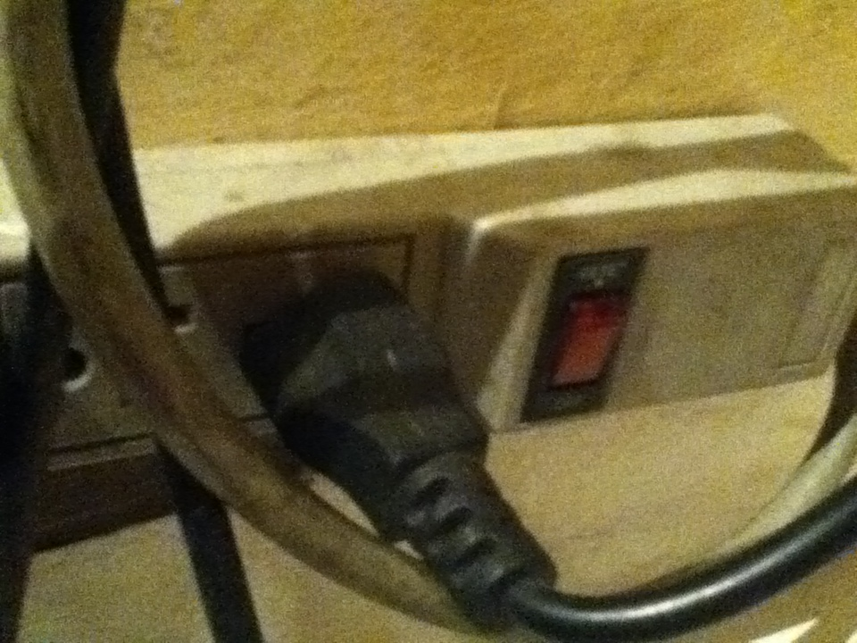
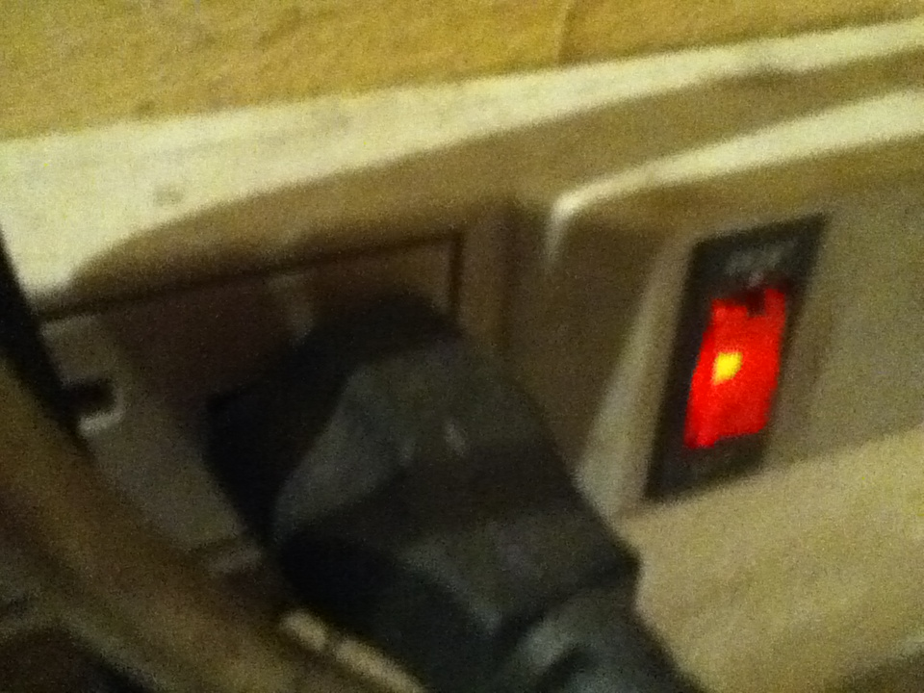
night
day

Slide 10
Having plants is good because it makes oxygen and we decrease a little bit global warming.

Slide 11
Reusable bags are good because plastic bags pollute and it takes alot of time to recycle

Slide 12
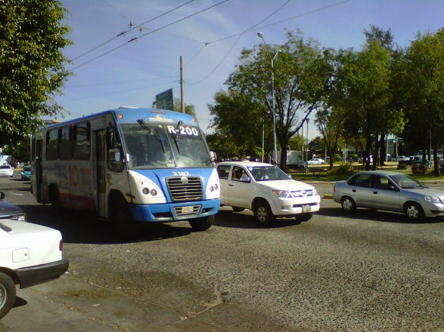
If you use a public bus is better because you use less gasoline so it doesn’t harm the atmosphere.
Imagine all the people on a bus using a car, it would pollute alot and also harm the atmosphere.

Slide 13
10 actions that increase the global warming

Slide 14
The lights where on and nobody was there to shut it off

Slide 15
The glade or other spray substances can harm our enviroment because the gas contains bad things for the atmosphere .

Slide 16
Air conditioners use fossil fuels that harm the atmosphere and if we harm our atmosphere it may produce a whole on it and it would enter hotter sun rays and would increase the global warming.

Slide 17
smoke
The smoke produces a lot of substances that one of those is green house gasses that harm the atmosphere.

Slide 18
If we waste water we have less water on the country and less for the world.

Slide 19
NO BUS: Using buses is good for the enviroment because a lot of peopole is in one bus insted of all the peopole having 1 car each , its better using 1 bus than 10 or even 20 cars. Cars use gasoline and gasoline are burned fossil fuels that damage our earth.

Slide 20
The light and the TV where on and nobody was there , the place was alone .And we waste energy and the energy is made of fossil fuels that harm our earth

Slide 21
The trash pollutes the world so this is trash on the GROUND

Slide 22
The airplane wastes alot of gas because gasoline is made of burned fossil fuels

Slide 23
Watch the video

Slide 24
Watch the video

Slide 25
So ,can you?
TAKE A CHANCE TO MAKE THE CHANGE
SAVE THE WORLD

Slide 27
SOURCES:
http://www.nmsea.org/Curriculum/Primer/Global_Warming/fossil_fuels_and_global_warming.htm
http://content.time.com/time/nation/article/0,8599,108904,00.html
http://www.slate.com/articles/health_and_science/the_green_lantern/2008/09/should_we_dispose_of_disposals.html
http://environment.nationalgeographic.com/environment/global-warming/
http://www.waste-management-world.com/articles/print/volume-9/issue-4/features/waste-sorting-a-look-at-the-separation-and-sorting-techniques-in-todayrsquos-european-market.html
http://electrical.about.com/od/electricaldevices/f/Power-Strips-And-Saving-Energy.htm
http://www.seramis.com/plant-care-center/why-houseplants-are-good-for-you/
http://www.leavenotracedude.com/waste-disposal.shtml
http://carbusters.org/2011/12/11/the-environmental-impact-of-cars-and-trains/
http://www.reusethisbag.com/25-reasons-to-go-reusable.php
http://environment.about.com/od/greenlivingdesign/a/public_transit.htm
http://wiki.answers.com/Q/Why_is_leaving_lights_on_bad#slide1
http://www.silentmenace.com/-Air_Fresheners_.html
http://www.earthtimes.org/green-blogs/green-living/how-air-conditioning-is-heating-things-up-11-Sep-12/
http://tiki.oneworld.net/pollution/pollution4.html
http://technorati.com/lifestyle/green/article/wasteful-individuals-leave-water-running/
http://www.pistonheads.com/gassing/topic.asp?h=0&f=95&t=803213&mid=0
http://wiki.answers.com/Q/How_do_airplanes_affect_the_environment#slide1

