Slide 1
20 20 Project
i spy

Slide 2
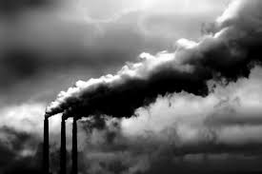
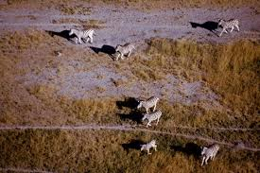
Greenhouse effect
The result of greenhouse gasses trapping the sun heat and keeping a unit close to the air, crusial and essential for life.
Greenhouse gasses are caused by pollution that animals and humans make.
For example:
HUMANS ANIMALS

Slide 3
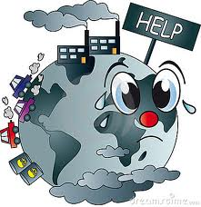
Global Warming
The increase of Earth average surface temperature due to effect greenhouse gasses trapping heat.

Slide 4
Photo #1

Slide 5
Video #1

Slide 6
Causes and Consecuences
Green gas emission:
Cause: Burning of fossil fuels in cars, factories, and electricity production.
Consecuence: Contamination on the city, farms and towns.

Slide 7
Photo #2

Slide 8
Elements
Carbon dioxide (CO2) exsist thanks of the fossil fuel burning and deforestataion.
Methane (CH4) sourcerice cultivation ,cattle i sheep ranching, decay from landfills and minning.
Water vapor (h2O) is the most important greenhouse gas!!!

Slide 9
Video #2

Slide 10
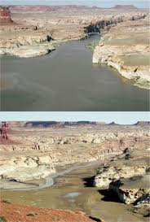
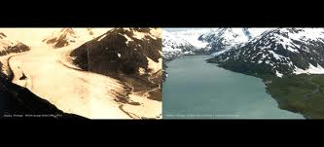
Proof of global warming
Alaska in 1914 was ice.
2004 is almost a lake. Colorado river in 2002
Colorado river 2002 is a complete river.
2003 small ( not a river any more) concluding a desert.
Alaska 1914 Alaska in 2004
Colorado river in 2003

Slide 11
Photo #3

Slide 12
Effects of global warming due to the unbalance of greenhouse gasses
Habitats damage and species extinction.
Changes in water supplies; contamination of fresh water.
More severe storms; huricanes and floods.
Droughts, and changes in weather patterns

Slide 13
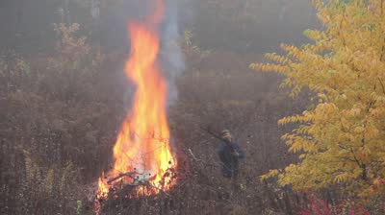
Cause that encrease gasses to the atmosphere
Deforetation: cutting down trees and the wood burning.
population growth: more people equals more contamination.

Slide 14
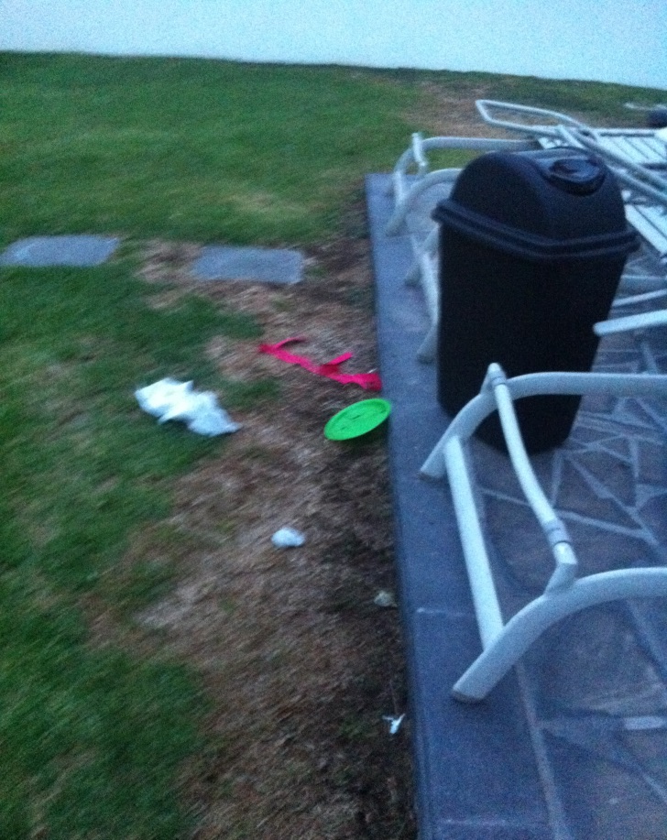
Photo #4

Slide 15
1 more bad photo

Slide 16
AND ALSO 1 MORE GOOD

Slide 17
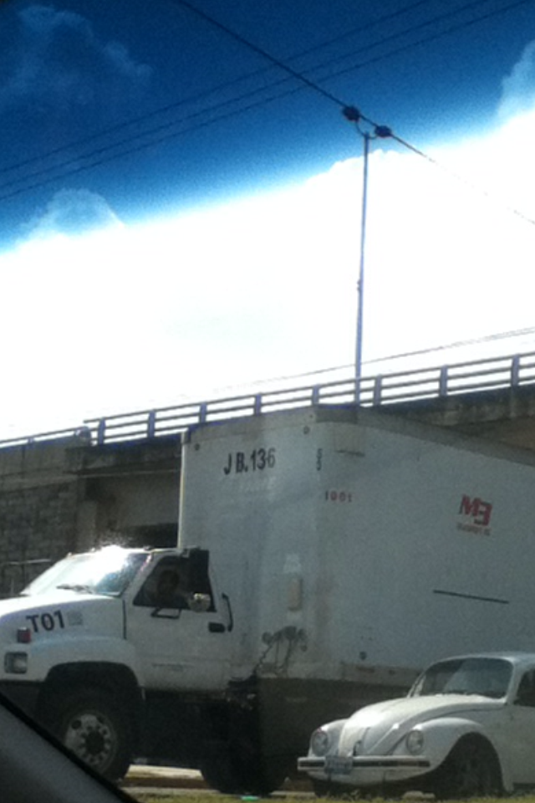
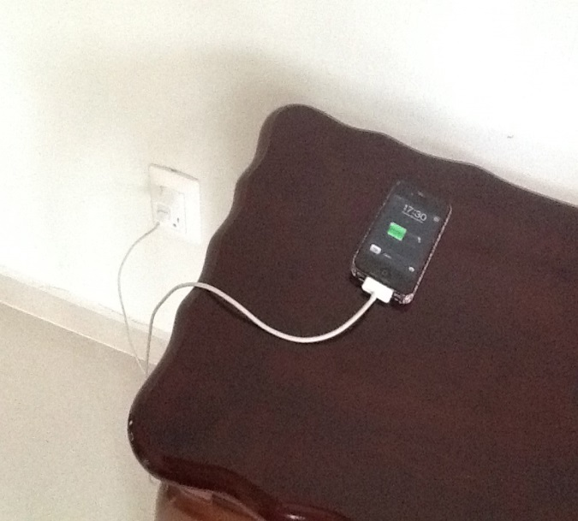
More photos

Slide 18
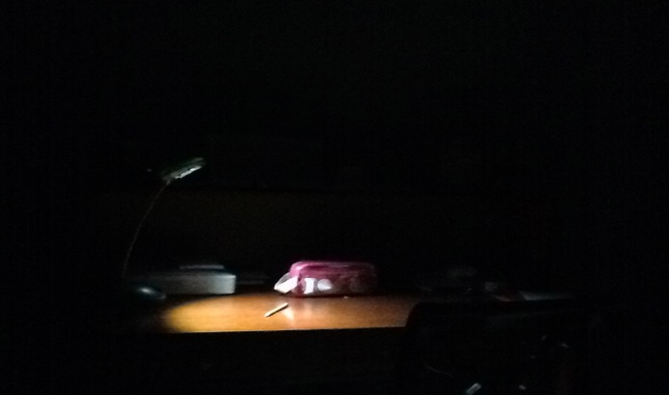
MANY MORE GOOD

Slide 19
Thanks!!
Whith love:
Pablo B.
Paola B.
Jose Fernando V.
Alexa Fernanda H.

