Slide 1
Social Studies project 20/20
BY: Lizete Gonzales, Lorenza McMullen , Selma Sánchez and Gonzalo López.

Slide 2
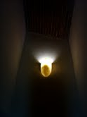
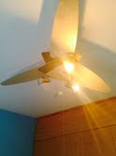
Light
We waste alot of light every day sometimes when we go out of home we leave lights on.

Slide 3
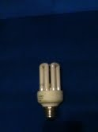
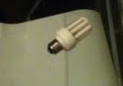
Reduce Light
With this buld we can reduce the waste of light or opening curtains.

Slide 4
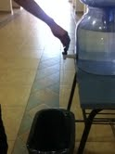
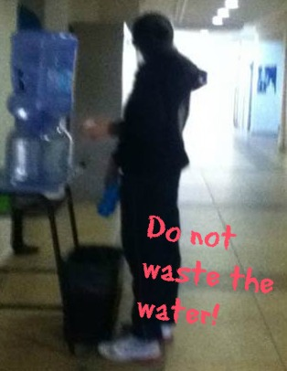
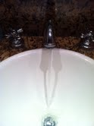
WATER
We waste alot or water washing your hands , shawering and leting the water fall.

Slide 5
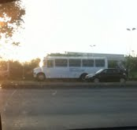
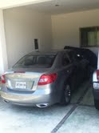
CARS
With the cars we pollute the air alot because of the smoke that cars produce.
The new cars pollute less than the old ones.

Slide 6
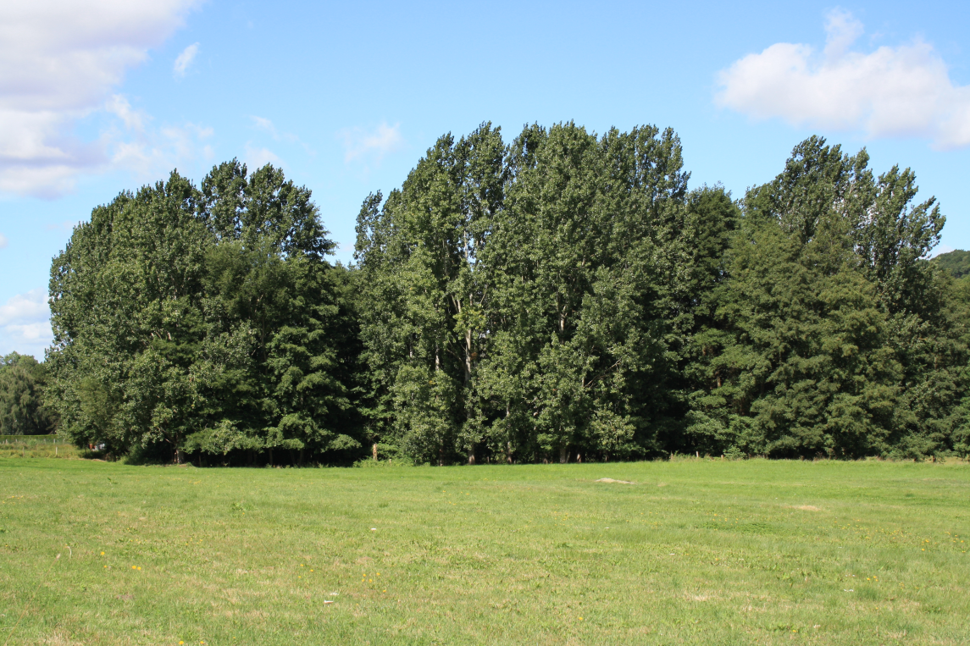
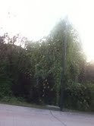
TREES
The trees help to reduce the smoke and turned to clean air.

Slide 7
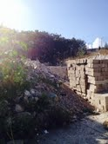
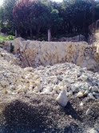
HOUSES
But we are finishing with the trees building houses.

Slide 8
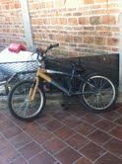
BICICLES
We can reduce the cars by using bicicles or walking.

