Slide 1
SAVING THE WORLD
By:Andrea Estrella, Nicolás Vásquez, José Mateo González, Erick Daniel Luna.

Slide 2
Introduccion:
Today were presenting this project in which we are showing what we have done for our enviorment. And what actions are for the good or bad of the planet.

Slide 3
Global warming and the Green-house effect:
What´s the difference?
The difference between the Green-house effect and global warming is that the Green-house effect is the cause of the gobal warming.

Slide 4
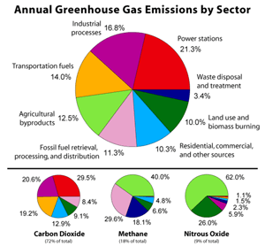
Click to watch video.

Slide 5
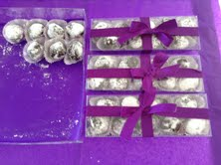
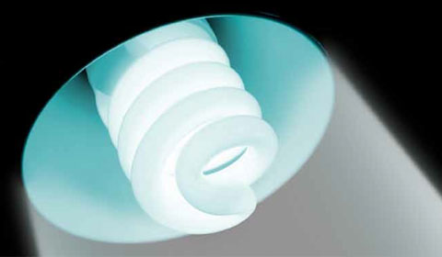
Good actions:
RECYCLE the plastic bags
Instead of using the big box
with a lot of space left they
used the small boxes that fit perfectly
and reduced plastic
Have saver bulbs to save energy

Slide 6
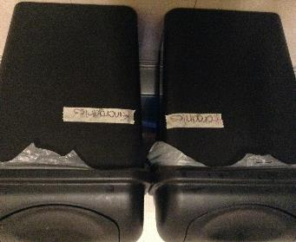
That energy-saber plug uses the energy that only one plug uses and saves energy
Recycle the garbage, inorganics and organics.

Slide 7
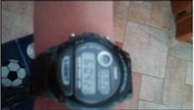
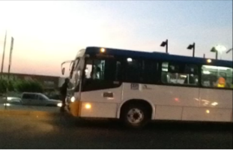
Plant trees at your front and back yards
To reduce carbon dioxide at the air
Take short baths, 5 to 7 minutes to save water
Take the bus for transportation and reduce the carbon dioxide at the air.

Slide 8
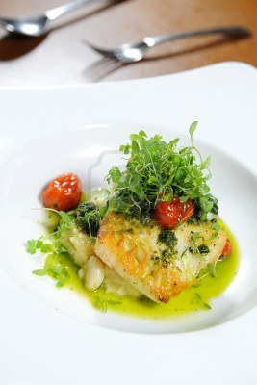
Use recycled paper to save trees
Eat a lot of fruits and vegetables
and try not to eat exotic animals

Slide 9
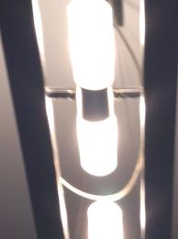
Bad actions:
Don´t leave the cables plugged to save energy.
Turn off the lights when you aren´t using them.

Slide 10
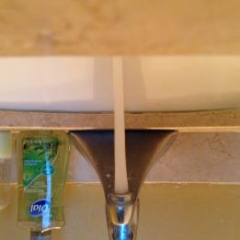
Do not buy aerosol cans because they contaminate a
lot
Save water!!!!!!!!!!! And close the water when you
Are brushing your teeth.

Slide 11
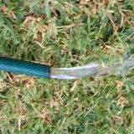
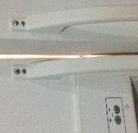
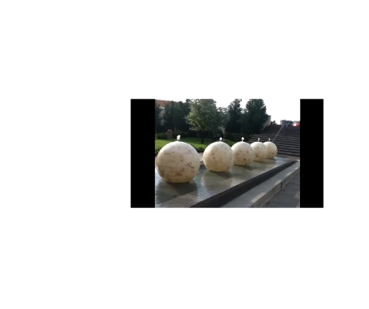
Do not burn garbage or other fossil fuels
Save the water and close the water hose.
Close the refrigerator to save energy
Turn off the fountains when you are´t using
them

Slide 12
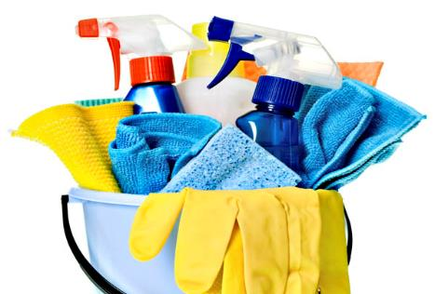
The water hose was spilling and wasting water.
All the cleaning products
contaminate a lot so try to
use pruducts that are
friendly with the
Enviorment

Slide 13
Resources.
Almost all photos taken by us.
The only info. that was taken from internet was the chart and video.

